Slide 1
WEBSITE PROJECT ASSIGNMENT
By Naduja Mohamed
Student ID: 23027771

Slide 2
AGENDA
Database design and normalisation
Design Choices and implementation
LESP Aspects
Demonstration of Website Functionality
Summary and Self-Evaluation

Slide 3
LESP ASPECTS
1
LEGAL
2
ETHICAL
3
SOCIAL
User informed consent:Terms and conditions and privacy policy clearly outlined for user. Users are informed on how their data is being used
Data security measures:Implemented secure authentication and encryption to ensure user data is protected from unauthorised access. User can see their dashboard only once they are logged in.
Transparency and confidentiality: Website ensures transparency with user by clearly communicating data collection policy. User is well informed on how their data is to be collected and who has access
Accessibility:Website ensures it is inclusive and accessible to as many people as possible.features include colour contrast considerations for color blind people and alt text for images.

Slide 4
LESP ASPECTS
code quality:for the most part website adheres to coding standard practices such as comments, read me file and ensuring readability

Slide 5
Design Options and Implementation
a simple and intuitive layout was chosen to improve user experience and navigation.
Colour palette: A cohesive and simple colour palette was selected to represent professionalism and clarity.
Navigation: Clear and simple navigation options were built to provide quick access to various areas of the website for convenience and easy use.
Implementation Strategy:
Responsive Design: My website is responsive, allowing for optimal viewing and interaction on a variety of devices and screens.
Security Measures: To safeguard user from details being accessed by just anyone, login system was set up.
User friendly forms: forms are implemented with clear input fields and prompts to make the process easy for user to submit

Slide 6
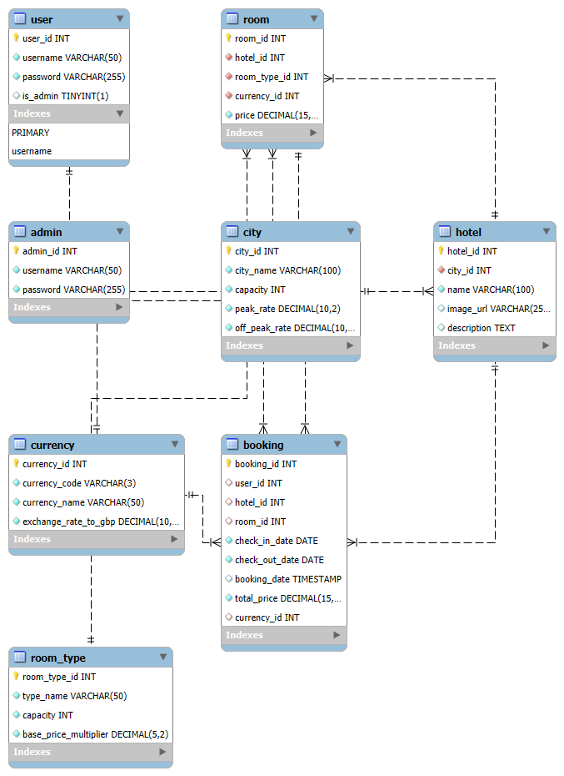
Db design and normalisation
Design decision leading to 3nf:
User and Admin Separation: By keeping the user and admin tables apart, it is possible to distinguish between administrators and ordinary users.
Relationship between City and Hotel: In the hotel table, the foreign key city_id denotes the association between each hotel and a city. In doing so, redundancy is avoided and data integrity is preserved.
Room Types: The room_type table lists several room kinds along with the characteristics that correspond to them, such as price multiplier and capacity. This prevents repeating data and aids in the proper management of room information.

Slide 7
Currency Management: A variety of currencies and their rates of exchange to GBP are handled by the currency table. This makes handling prices in different currencies flexible.
Booking Information: The booking table records the user, hotel, room, dates of check-in and check-out, booking date, total cost, and currency, among other important booking facts. This structure supports detailed booking records

Slide 8
Evaluation: Strengths and Weaknesses
The website features quality aspects such as the booking system and login/register functionalities. It has a nice look and feel to it with easy to access and convenient layout.
Design decisions: Users can easily explore and locate information on the website thanks to its clear and simple layout.
Responsiveness: The design offers a consistent user experience across desktop, tablet, and smartphone platforms by adjusting effectively to various screen sizes.
In the future, I would improve on providing more functionalities on the website and ensuring all aspects function as they should such as the user dashboards providing functionality such as viewing booking,updating etc.. I would add more features that adhere to the LESP so that it is even more accessible for users such as those who can not see.

